Slide 1

Foundation Course in CGE Modeling Using IFPRI’s Static CGE and Microsimulation Models

Slide 2
Overview _{(Parts 1-7)}
Why Do Economywide Analysis?
Social Accounting Matrices (SAMs)
SAM Multiplier Analysis
Simple CGE Model
IFPRI Standard CGE Model
Microsoft-Excel® Interface
Extending the Standard Model

Slide 3
Part 1 Why Do Economywide Analysis?

Slide 4
Agrifood Systems
Agriculture
Input suppliers
Traders
Off-farm components of the agrifood system are more important than on-farm components at higher-income levels.
Processors
Traders
Share of national GDP (%)
Share of agrifood GDP (%)
Share of off-farm agrifood GDP (%)
Food services

Slide 5
Economywide Models
Activities (producers)
Computable General Equilibrium
Economic linkages
Between sectors, households, government & rest of world
Resource competition
Factor markets (land, labor, capital)
Product markets (supply, demand)
Macro consistency
Government (revenues, spending)
Savings-investment
Current account (foreign exchange)
Farming
Trading
Processing
Non-AFS
Investments & subsidies
Regional
Trade
Factor markets
Product markets
Rest of world
Aid
Regional
National
Taxes
Government
Households (consumers)
Regional migration & remittances
Rural
poor
Rural
nonpoor
Social transfers
Urban
poor
Urban
nonpoor
Regional

Slide 6
Types of Economywide Studies
Foresight Analysis
Tracking progress
Setting targets & goals
Impact Evaluation
Capturing spillovers
Estimating benefits & costs
Strategic Planning
Evaluating Programs
CGE Model
Prioritizing Portfolios
Policy & Investment Choices
Identifying priorities, Optimizing budgets

Slide 7
Data Reconciliation
Firm surveys
Input costs
Profits
Household surveys
Product consumption & diets
Labor, land & enterprise earnings
Taxes & transfers
National accounts
GDP by sector
Product supply & use
Transaction costs
Labor force surveys
Jobs & earnings by sector
Determinants of employment
Balance of payments
Product trade flows
Remittances
Foreign investments
Development assistance
Social Accounting Matrix
Micro- simulation
CGE
Model
Government
Consumption spending
Social transfers
Tax collections
Debt & interest
Simulation design
Program evaluation studies
Estimates of direct policy impacts
Behavioral change
Public finance studies
Tax & expenditure policy
Borrowing & debt repayment
Firm & industry studies
Changes in value chains & technologies

Slide 8
Part 2 Social Accounting Matrices (SAMs)

Slide 9
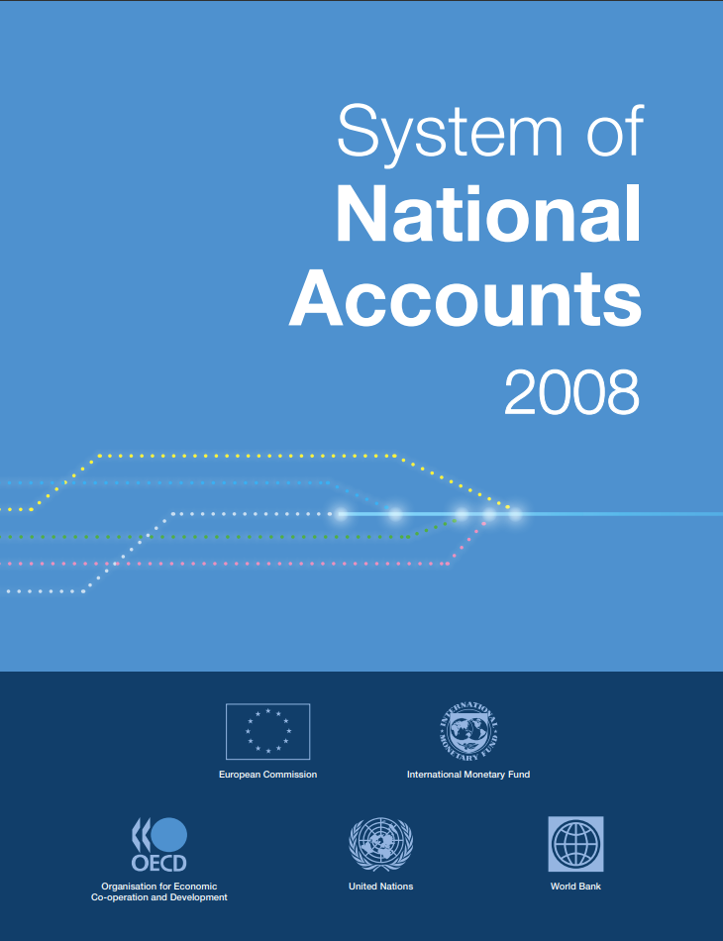
What Is a SAM?
SAMs are national accounting frameworks or databases
SAMs capture the circular flow of receipts and payments between economic agents and markets during a given year
SAMs include all sectors, factors, households, government and the rest of the world (i.e., economywide)
Every payment becomes someone else’s income (i.e., consistent double-entry accounting)

Slide 10
Circular Flow and Accounting Identities
F
Factor costs
Wages & rents
S
Factor Markets
Domestic private savings
S
Direct taxes
Public savings
Firms
Households
Government
Savings & Investment
Intermediate demand
Social transfers
T
Indirect taxes
Product Markets
Sales
Private consumption
Public consumption
Investment demand
M
C
G
I
X
Imports
S
Exports
Foreign Markets
Foreign savings or capital inflows
GDP at market prices = C + I + G + X – M
Total Investment I = Total Savings S
GDP at market prices = GDP at factor cost F + Indirect Taxes T

Slide 11
SAM Structure
 | ACT | COM | FAC | HHD | GOV | INV | ROW | TOT
ACT |  | Marketed output |  |  |  |  |  | Activity incomes
COM | Intermediate demand |  |  | Private consumption | Public consumption | Investment demand | Exports | Total demand
FAC | Value added |  |  |  |  |  |  | Factors incomes
HHD |  |  | Income distribution |  | Social transfers |  | Remittances | Household incomes
GOV | Producer taxes | Tariffs, VAT & excise taxes |  | Direct taxes |  |  | Foreign aid | Government revenues
SAV |  |  |  | Private savings | Public savings |  | Foreign savings | Total savings
ROW |  | Imports | Repatriated profits |  | Debt repayments |  |  | Foreign payments
TOT | Gross output | Total supply | Factor payments | Household expenditures | Government expenditures | Total investment | Foreign receipts
Incomes across rows
Expenditures down columns

Slide 12
Macro SAM | Data Sources
Three main data sources:
National Accounts (activity and commodity accounts)
Government Financial Statistics (spending and tax accounts)
Balance of Payments (external account)
Standardized concordance between SAM and classification systems
GFS2014 & BOP6 → SNA 2008 → Macro SAM accounts
Inconsistent values across sources requires reconciliation:
Consistency with national accounts usually afforded highest priority, followed by BOPs and then GFS

Slide 13
Macro SAM | Entries
Incomes across rows
 | Act | Com | Fact | Ent | Hhd | Gov | Tax | S-I | Stk | Wld | Tot
Activities |  | NA |  |  |  |  |  |  |  |  | NA
Commodities | NA |  |  |  | NA | NA |  | NA | NA | NA | NA
Factors | NA |  |  |  |  |  |  |  |  | BOP | X
Enterprises |  |  | X |  |  | GFS |  |  |  | BOP | X
Households |  |  | X | X |  | GFS |  |  |  | BOP | X
Government |  |  | GFS | GFS | GFS |  | GFS |  |  | BOP | GFS
Taxes | NA | NA | GFS | GFS | GFS |  |  |  |  |  | GFS
Savings |  |  |  | ? | X | GFS |  |  |  | BOP | X
Stock change |  |  |  |  |  |  |  | NA |  |  | X
Rest of world |  | NA | BOP | BOP | BOP | BOP |  |  |  |  | BOP
Total | NA | NA | X | X | X | GFS | GFS | NA | NA | BOP
Expenditures down columns
NA National Accounts
GFS Government Financial Statistics
BOP Balance of Payments
X Convention or residual

Slide 14
Macro SAM | Details
Incomes across rows
 | Act | Com | Fact | Ent | Hhd | Gov | Tax | S-I | Stk | Wld | Tot
Activities
Commodities
Factors
Enterprises
Households
Government
Taxes
Savings
Stock change
Rest of world
Total
Expenditures down columns
Factors
Labor | Land | Capital
Taxes
Activities (producer) | Export duties | Import duties | Sales or VAT | Factor | Direct

Slide 15
Supply-Use Table | Details
Incomes across rows
 | Act | Com | Fact | Ent | Hhd | Gov | Tax | S-I | Stk | Wld | Tot
Activities
Commodities
Factors
Enterprises
Households
Government
Taxes
Savings
Stock change
Rest of world
Total
Multiple activities + commodities
Expenditures down columns
IFPRI Standard NEXUS SAM structure
Individual countries may vary

Slide 16
Supply-Use Table | Data Sources
Main data sources:
National accounts (GDP by sector, trade margins)
Agricultural and industrial production data and surveys
Input-output table
Trade and tax data (esp. VAT and customs duties)
Household expenditure survey (consumption demand vector)
Standardized concordance between SAM and classification systems
ISIC3.1, ISIC4, HS2012, COICOP → Disaggregated SAM accounts
Inconsistent values across sources requires reconciliation:
Balanced using cross-entropy techniques in GAMS®

Slide 17
Social Transfers | Details
Incomes across rows
 | Act | Com | Fact | Ent | Hhd | Gov | Tax | S-I | Stk | Wld | Tot
Activities
Commodities
Factors
Enterprises
Households
Government
Taxes
Savings
Stock change
Rest of world
Total
13 factors
Expenditures down columns
15 households
IFPRI Standard NEXUS SAM structure
Individual countries may vary

Slide 18
Social Transfers | Accounts
Factors of production
13
Crop land | Crop, livestock, mining and nonagricultural capital | Rural and urban labor by education category
Household groups
15
Rural farm and nonfarm households and urban households by national per capita expenditure quintiles
IFPRI Standard NEXUS SAM structure
Individual countries may vary

Slide 19
Social Transfers | Data Sources
Main data sources:
Household & labor force surveys
Map sector of employment to Nexus activities
ISIC3.1, ISIC4 → Disaggregated SAM accounts
Map consumption items to Nexus commodities
COICOP, etc. → Disaggregated SAM accounts
Maintain macro SAM and non-factor/household accounts
Only imbalances are for detailed household accounts
Balanced using cross-entropy in GAMS

Slide 20
Balancing SAMs | RAS Method
One approach is to use the RAS method
Rows and columns are uniformly scaled in iteration until totals converge
Advantages: Simple to implement (even in Excel)
Shortcoming: Can do significant “damage” to the original data (will adjust cells, even if they are not causing the imbalance)
 | Act | Com | Fact | Ent | Hhd | Gov | Tax | S-I | Stk | Wld | Tot
Activities |  |  |  |  |  |  |  |  |  |  | X
Commodities |  |  |  |  |  |  |  |  |  |  | X
Factors |  |  |  |  |  |  |  |  |  |  | X
Enterprises |  |  |  |  |  |  |  |  |  |  | X
Households |  |  |  |  |  |  |  |  |  |  | X
Government |  |  |  |  |  |  |  |  |  |  | X
Taxes |  |  |  |  |  |  |  |  |  |  | X
Savings |  |  |  |  |  |  |  |  |  |  | X
Stock change |  |  |  |  |  |  |  |  |  |  | X
Rest of world |  |  |  |  |  |  |  |  |  |  | X
Total | X | X | X | X | X | X | X | X | X | X

Slide 21
Balancing SAMs | Cross-Entropy Method
Better approach is to use the cross-entropy method
Each cell is adjusted individually (rather than entire rows & columns)
Minimize deviation from original data (using error distributions)
Advantages: Focus more on cells that are causing imbalances
Shortcoming: More complex (need GAMS rather than just Excel)
 | Act | Com | Fact | Ent | Hhd | Gov | Tax | S-I | Stk | Wld | Tot
Activities |  |  |  |  |  |  |  |  |  |  | X
Commodities |  |  |  |  |  |  |  |  |  |  | X
Factors |  |  |  |  |  |  |  |  |  |  | X
Enterprises |  |  |  |  |  |  |  |  |  |  | X
Households |  |  |  |  |  |  |  |  |  |  | X
Government |  |  |  |  |  |  |  |  |  |  | X
Taxes |  |  |  |  |  |  |  |  |  |  | X
Savings |  |  |  |  |  |  |  |  |  |  | X
Stock change |  |  |  |  |  |  |  |  |  |  | X
Rest of world |  |  |  |  |  |  |  |  |  |  | X
Total | X | X | X | X | X | X | X | X | X | X

